Slide 1
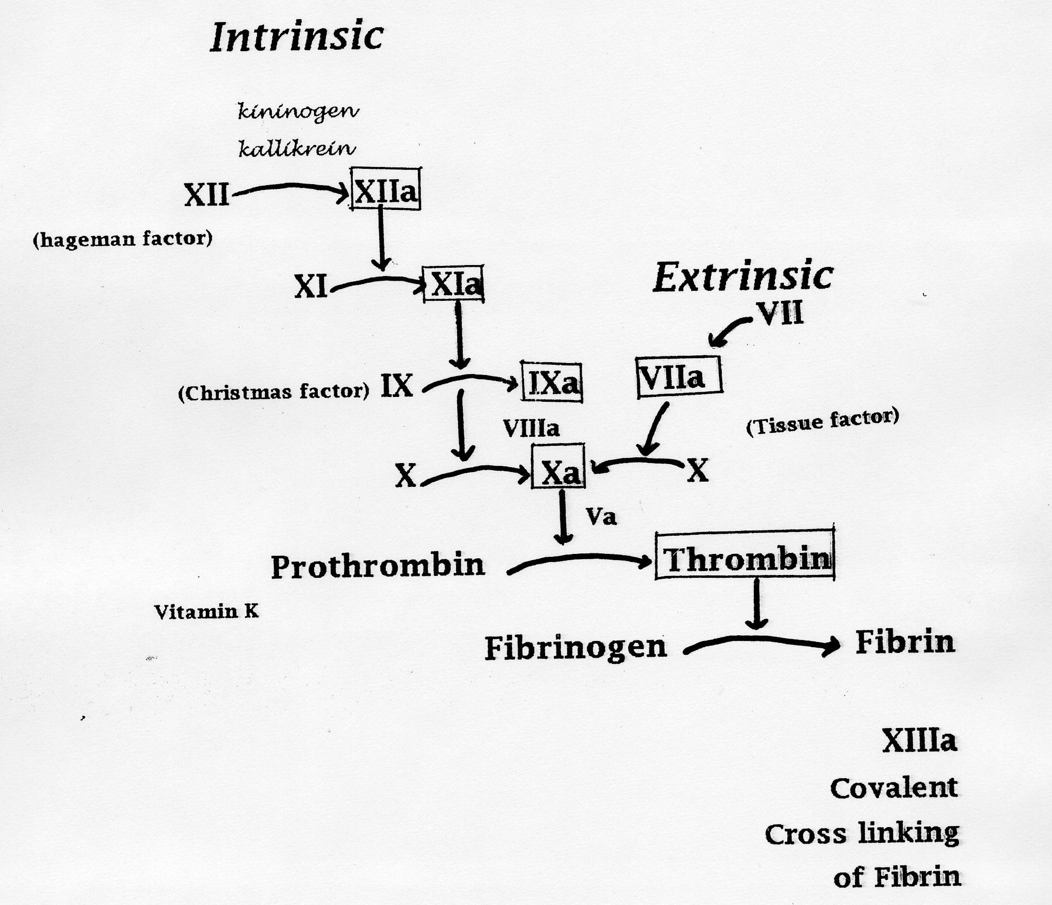
Blood Clotting Pathway

Slide 2
Prothrombin Thrombin
Vitamin K
Adds γCOO- to
glutamate
of prothrombin
Also VII IX X
Coumadin
Inhibits
vit K action

Slide 3
3.
Thrombin (hydrolysis
at arginine-glycine)
Aα
Bβ
γ
2
Fibrinogen
Fibrino peptide
2A+2B
2α, β, γ monomers (aggregate)
Fibrin
Thrombin – homologous to trypsin

Slide 4
4. Regulation of Clotting
a. Antithrombin III- inhibits thrombin
(forms irreversible
complex with it)
Also Blocks: XIIa
XIa
IXa, Xa
heparin – enhances action of
Antithrombin III
b. Lysis of clot
TPA
Plasmin
Plasminogen
CLoT
Serine
protease

